Slide 1
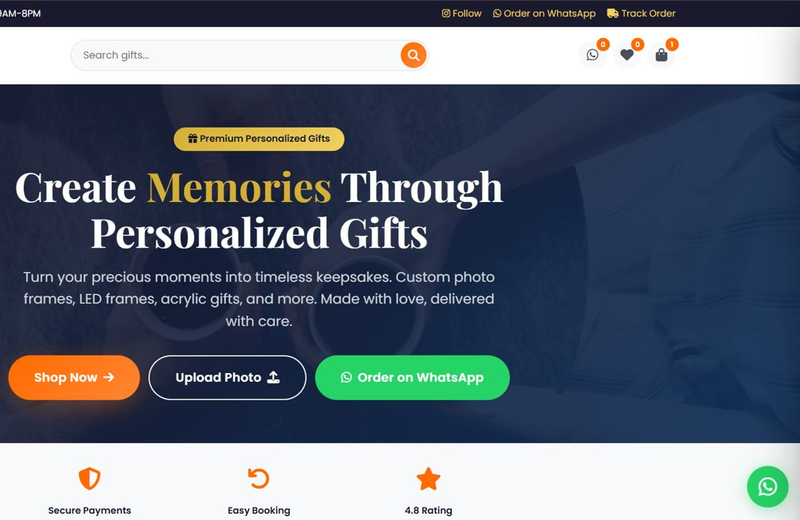
Sasi Arts – Personalized Gifts & E-Commerce Platform
FULL-STACK E-COMMERCE · PROJECT CASE STUDY
A digital storefront to discover, customize and order personalized gifts: photo frames, LED frames, acrylic gifts and more.
P. Bharath Kumar · Student ID: 2400030010
Live: sasi-arts.vercel.app
GitHub: github.com/bharathkumar1904/sasi-arts
Notes:
Intro: what the app does, who it is for, and that everything shown is verified from the repository.

Slide 2
02 Problem Statement & Objectives
Problem
Solution: Sasi Arts web app
• Customers need an easy way to discover personalized gifts
Product discovery
Customization
• Customization normally needs manual back-and-forth
Photo upload
Cart & checkout
• Customers want more than one way to order
→
Online payment (Razorpay)
WhatsApp ordering
• Payment and order tracking should be in one place
• The business needs a digital storefront
Order tracking
Corporate / bulk enquiry
Responsive UI
Result: one storefront covering discovery → customization → payment or WhatsApp order → tracking, plus an admin panel for the owner.
Sasi Arts · P. Bharath Kumar · 2400030010
2 / 10
Notes:
Problem to solution mapping.

Slide 3
03 System Architecture
User
1 · Frontend
2 · Backend / API
3 · Database
Customer on mobile or desktop browser
→
Static SPA: index.html, CSS, vanilla JS. Reads Supabase REST directly (js/supabase.js)
→
Vercel serverless (Node.js): /api/razorpay-order, /api/shipping, /api/supabase-proxy
→
Supabase PostgreSQL (15 tables, RLS) + Storage bucket for images
4 · EXTERNAL SERVICES
Razorpay
WhatsApp
EmailJS
Supabase Auth
Order creation + signature check on server; Checkout runs in browser
wa.me link with prefilled order text (no API call)
Admin invoice email, sent from browser
Email/password login for admin panel only
5 · Deployment: Vercel hosts static files, serverless functions and CDN; GitHub → auto-deploy. No separate courier API: shipping is an in-house pincode function.
Order path: cart (localStorage) → /api/shipping → /api/razorpay-order create → Razorpay Checkout → verify (HMAC) → Supabase orders + order_items → EmailJS invoice → tracking by Order ID
Sasi Arts · P. Bharath Kumar · 2400030010
3 / 10
Notes:
Walk the order path left to right.

Slide 4
04 Technology Stack
Frontend
Backend
Database
HTML5, CSS3, Vanilla JavaScript (ES6+), Font Awesome, Google Fonts (Playfair Display, Poppins)
Node.js on Vercel Serverless Functions, razorpay SDK (^2.9.0), Node crypto (HMAC-SHA256)
Supabase PostgreSQL with Row-Level Security; Supabase Storage for images
Authentication
Payments
External integrations
Supabase Auth (email/password) for the admin panel; JWT kept in sessionStorage
Razorpay Standard Checkout (UPI, card, netbanking)
WhatsApp (wa.me), EmailJS, QR Server API (api.qrserver.com). Delivery = in-house pincode API
Deployment
Development
Deliberately not used
Vercel (static + serverless + CDN), GitHub auto-deploy
Git, GitHub
React, Tailwind, Express, Next.js, TypeScript. Chosen to keep a small store simple, SEO-friendly and build-free
Sasi Arts · P. Bharath Kumar · 2400030010
4 / 10
Notes:
Only technologies present in the repo.

Slide 5
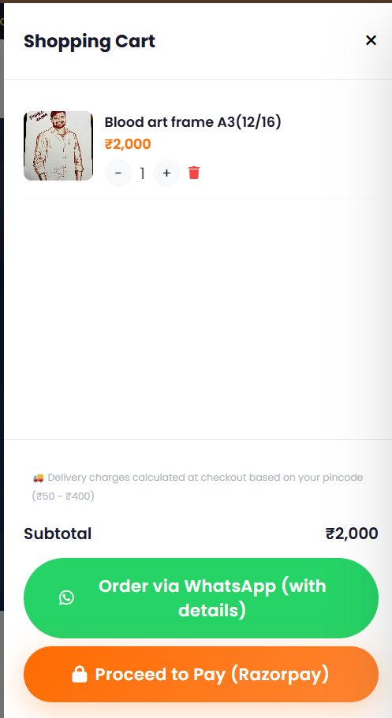
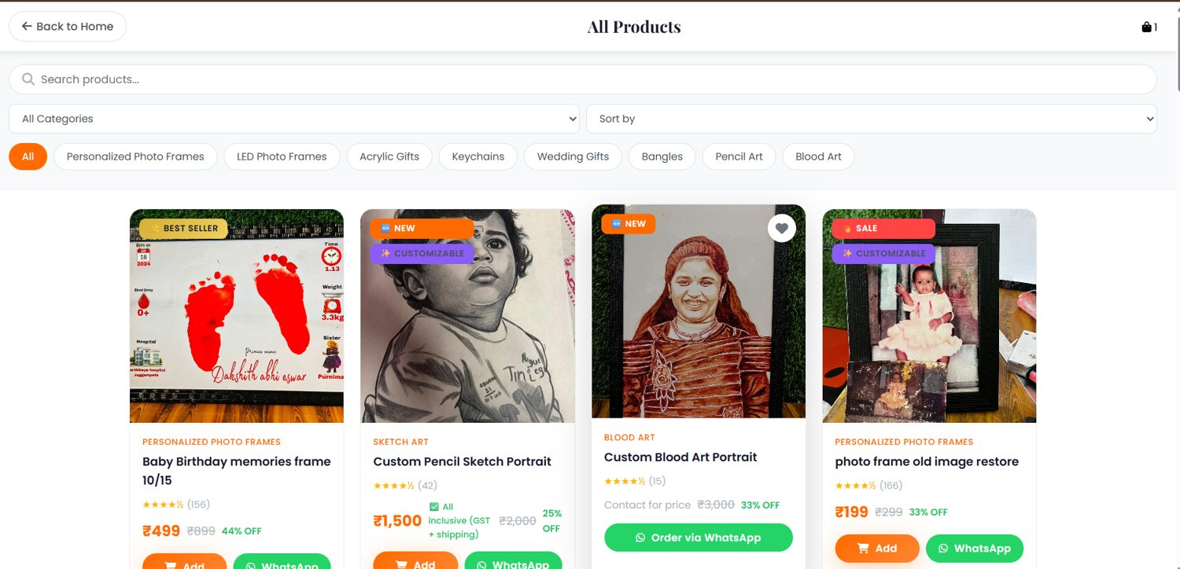
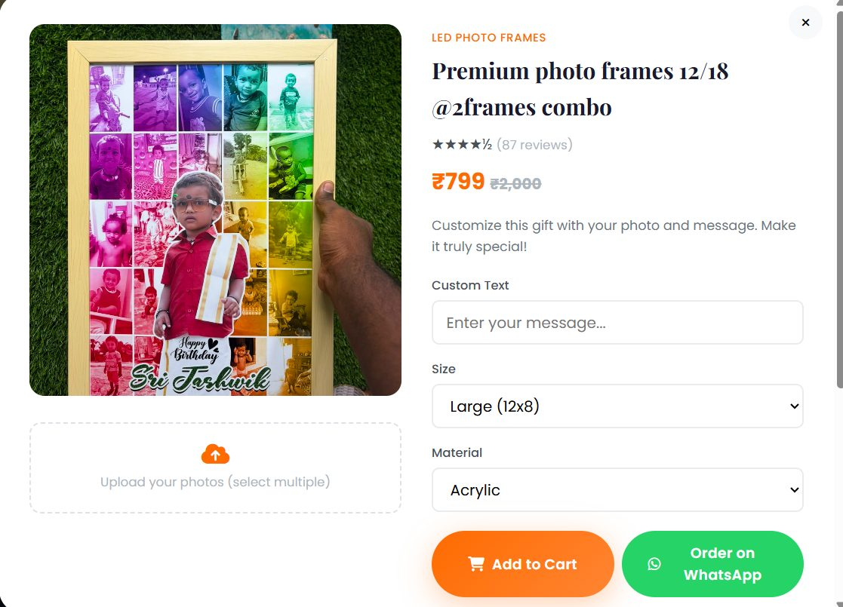
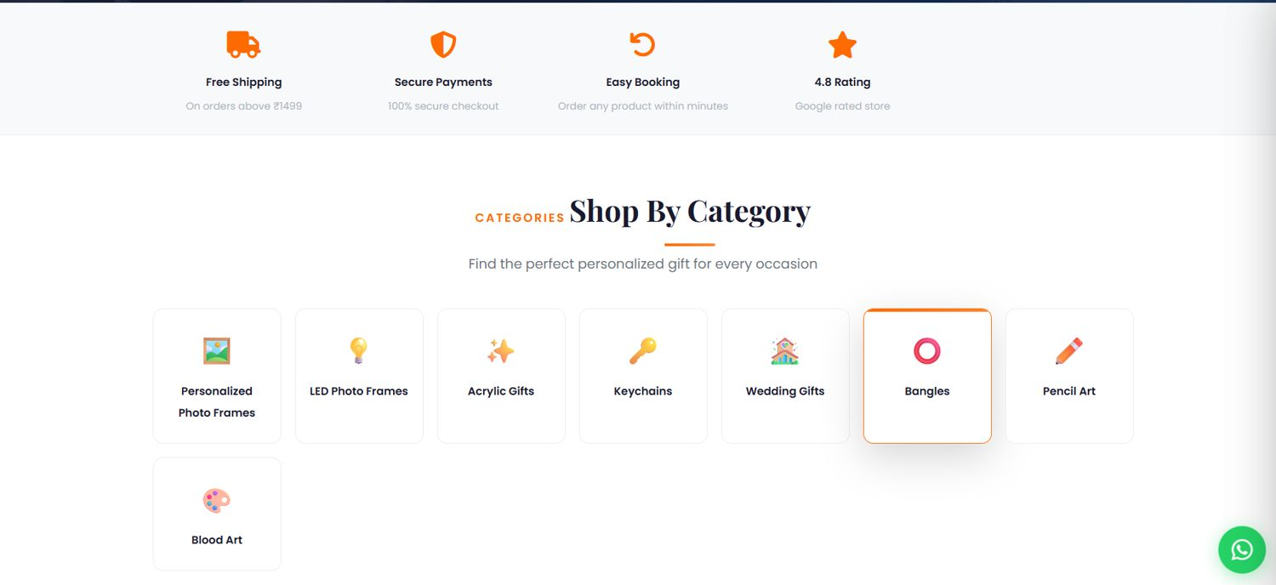
05 E-Commerce Functionality
Browse
Search / filter
View product
Customize
Add to cart
Delivery details
Shipping + GST
Razorpay or WhatsApp
Track order
Categories
Product catalogue
Customize modal
Cart + checkout
How data moves
One state object (cart, wishlist, WhatsApp Kart, orders) → saveState() → localStorage. Products load from Supabase products, merged over sample data and cached. Checkout reads cart + delivery form, then calls the API.
Sasi Arts · P. Bharath Kumar · 2400030010
5 / 10
Notes:
Screenshots from the live site.

Slide 6
06 Product Personalization
Upload
Drag-and-drop or file picker, accept=image/*, instant FileReader preview.
Options: custom text, size, material, multiple photos. The 3-step builder also has a font-style selector with live preview.
Validation
Browser checks type + 10 MB. The storage bucket also allows only JPEG, PNG, WebP, GIF up to 10 MB.
Storage
Photo → Supabase Storage bucket (uploads/…); public URL kept on the cart item.
Association
item.customization = {text, size, material, photos[]} → saved as JSON in order_items.customization.
On refresh
Cart persists in localStorage (sasiCart), so customization and photo URLs survive.
Sasi Arts · P. Bharath Kumar · 2400030010
6 / 10
Notes:
Honest note: if cloud upload fails, a local preview is kept and the user is told.

Slide 7

07 Payment, Ordering & Integrations
# | Flow | What happens
1 | Customer → Website | Delivery form; pincode → /api/shipping gives charge; flat GST ₹23.33 added
2 | Website → Backend | POST create (amount × 100) → Razorpay orders.create → order_id
3 | Customer → Razorpay | Checkout modal: UPI / card / netbanking
4 | Website → Backend | POST verify: server recomputes HMAC-SHA256(order_id|payment_id) with secret from env
5 | Website → Order DB | Only if verified: save orders + order_items to Supabase; local copy as backup
6 | Confirmation | Cart cleared, EmailJS admin invoice, toast with Order ID
WhatsApp
Prefilled wa.me message carries the cart/quote for custom or assisted orders.
Delivery & GST
Pincode zones (₹50–₹250) computed in /api/shipping. GST is a flat configured amount, not a percentage.
Failure handling
Dismissed checkout → “Payment cancelled”. Failed verification → error toast, order not saved.
Sasi Arts · P. Bharath Kumar · 2400030010
7 / 10
Notes:
Razorpay chosen for UPI/cards/netbanking in India. Server-side verification IS implemented in api/razorpay-order.js.

Slide 8
08 Database, Backend & Security
orders
order_items
Implemented
id, customer_*, address, pincode, subtotal, shipping, tax, total, status, payment_id
1 ─ ∞
order_id, product_name, price, qty, customization, image
Razorpay secret only in Vercel env vars · HMAC verification on server · Supabase Auth for admin (JWT in sessionStorage) · RLS: public insert/read where needed, admin-only writes · 10 MB upload limit
products
reviews
id, name, category, price, stock, is_active, image
1 ─ ∞
product_id, name, rating, text
customers
wishlists
Known gaps (and fixes)
name, email, phone, total_orders
1 ─ ∞
customer_id, product_id
Order total is computed in the browser; server does not re-price from DB → recompute on server. Orders are publicly selectable for tracking → lookup by ID via a function. CORS is open (*). Public upload policy, no rate limit.
+ 9 more tables: categories, leads, offers, corporate_orders, loyalty_members, campaigns, reminders, newsletter. order_items has foreign keys to orders (cascade delete) and products; customization is JSONB; order_items copies product name and price.
Sasi Arts · P. Bharath Kumar · 2400030010
8 / 10
Notes:
Be upfront about gaps; it shows engineering judgement.

Slide 9
09 Technical Challenges & Solutions
Challenge | Problem → Implementation → Result
Secure payments | Browser cannot be trusted → create + verify run in a serverless function; secret in env; HMAC-SHA256 check → order saved only when verified.
Custom image uploads | Photos must survive checkout → upload to Supabase Storage, keep URL in cart item and order_items; 10 MB client check; local preview fallback.
Cart state | No framework → one state object + saveState() to localStorage; cart, wishlist and orders persist across refresh.
Product data | Admin edits must show live → Supabase products merged over sample data, cached; CACHE_VERSION clears stale data.
Order tracking | Customers need status without accounts → ORD-id, lookup local then Supabase, 5 status steps updated by admin.
External APIs / CORS | Mobile and CORS issues → /api/supabase-proxy relay; shipping API has a client-side fallback.
RLS errors (42501) | Anonymous checkout blocked by RLS → added scoped public INSERT policies; admin writes need auth.
Responsive + deploy | 768px breakpoint, hamburger menu; ?v= cache-busting and Vercel headers fix stale JS after deploys.
Sasi Arts · P. Bharath Kumar · 2400030010
9 / 10
Notes:
No performance numbers claimed.

Slide 10
10 Interview Questions & Future Work
Frontend
Backend
Payments
1 Why vanilla JS? 2 How is cart state kept? 3 How does customization flow? 4 How is it responsive?
5 API architecture? 6 How is an order created? 7 Input validation? 8 Handling API failures?
11 Razorpay flow? 12 Preventing fake confirmation? 13 Payment OK but order save fails?
Database
Security
Future improvements
9 Explain the schema. 10 How to optimize product/order queries?
14 Where are secrets stored? 15 How to protect customer data?
Admin dashboard, inventory automation, order notifications, image CDN, search, recommendations, scalable backend, tests, CI/CD
Thank You
Live Demo | GitHub
Sasi Arts · P. Bharath Kumar · 2400030010
10 / 10
Notes:
Answer 12 and 13 using the verified flow; mention the localStorage fallback.

Slide 11
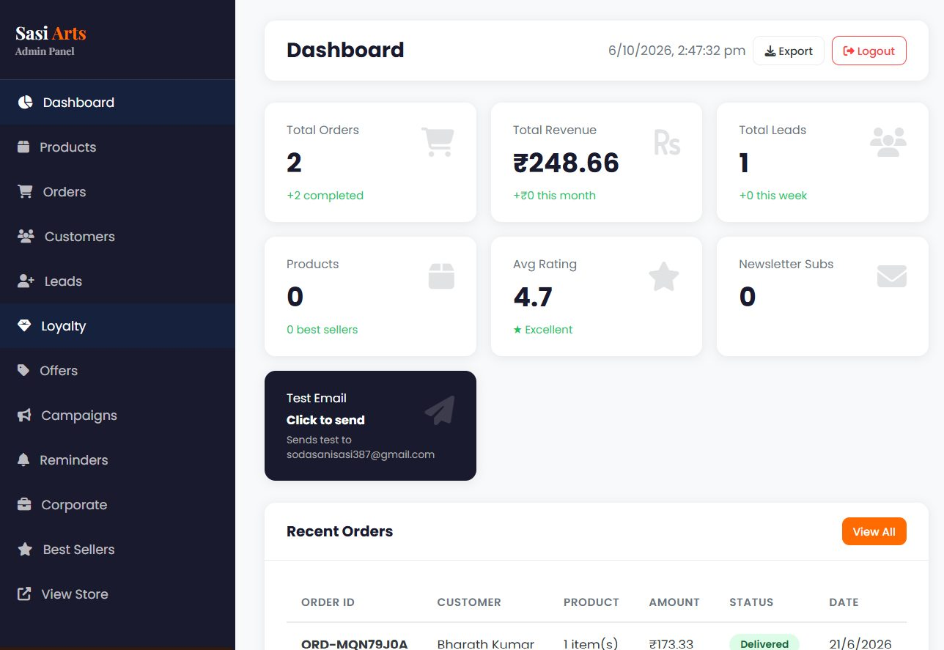
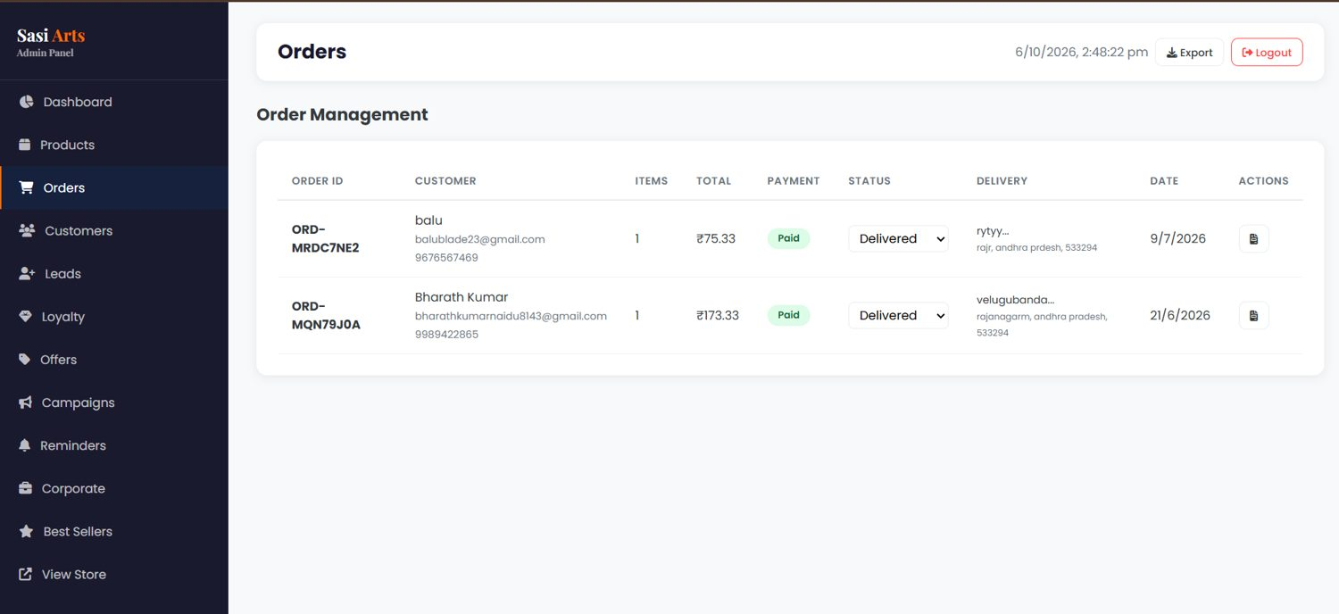
A1 Admin Panel
Access
Separate admin/index.html behind Supabase Auth (email/password); public site never loads admin JS.
11 tabs
Dashboard, Products, Orders, Customers, Leads, Loyalty, Offers, Campaigns, Reminders, Corporate, Best Sellers.
Dashboard: orders, revenue, leads, products
Operations
Product CRUD with image upload, order status dropdown, printable invoice, leads CSV export.
Order management with status updates
Sasi Arts · Appendix · P. Bharath Kumar · 2400030010
A1 / 7
Notes:
Admin is a separate page for security and load reasons.

Slide 12
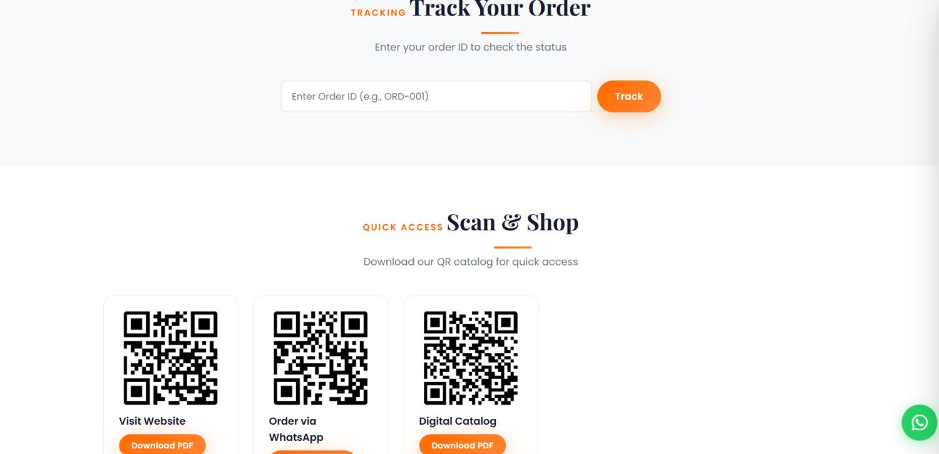
A2 Order Tracking
Order ID
ORD- + Date.now() in base-36, generated when payment is verified.
Lookup
Checks localStorage first, then Supabase orders + order_items.
Status steps
Placed → Processing → Production → Shipped → Delivered. Admin changes the status; the tracker renders it.
Track order by Order ID
Trade-off: tracking needs no login, but ID lookup relies on a publicly readable orders table (see A5).
Sasi Arts · Appendix · P. Bharath Kumar · 2400030010
A2 / 7

Slide 13
A3 Data Pipeline & Resilience
Page load
→
Async fetch
→
Merge
→
renderAll()
Products from localStorage cache or data.js samples
loadProductsFromDB() reads Supabase products
DB overrides sample IDs; result cached
Categories, products, cart, reviews, deal, QR
Supabase unreachable
Email fails
Shipping API fails
Falls back to sample products; orders saved locally; tracking still works from localStorage.
Invoice error is caught and logged; the order still completes.
Client-side estimate uses the same zone logic.
Why this design
A small store should keep working when a free-tier service is slow. The cost is two sources of truth (localStorage and Supabase), so reconciliation is manual today.
Sasi Arts · Appendix · P. Bharath Kumar · 2400030010
A3 / 7
Notes:
Local-then-sync.

Slide 14
A4 Payment Edge Cases
Fake payment confirmation?
Paid but order save fails?
User closes checkout?
Browser sends order_id, payment_id, signature. Server recomputes HMAC-SHA256 with the secret, which never leaves Vercel env. Mismatch → 400, order not saved.
Money is captured at Razorpay. Code retries by saving order and items separately, then keeps a local copy. Reconcile via payment_id in Razorpay dashboard. Improvement: Razorpay webhook.
ondismiss shows “Payment cancelled”. Cart is untouched; Razorpay order created but unpaid.
Honest limitation
/create trusts the amount from the browser. Fix: recompute total on the server from Supabase prices and shipping zone.
Sasi Arts · Appendix · P. Bharath Kumar · 2400030010
A4 / 7
Notes:
Answers to interview Q11-13.

Slide 15
A5 Security Hardening Roadmap
Gap | Fix | Where
Client-supplied payment amount | Recompute total from DB prices | /api/razorpay-order
Orders readable by anyone | Lookup by ID + phone via a restricted function | Supabase RLS / RPC
CORS set to * | Allow only the site domain | All /api functions
Anyone can upload to the bucket | Bucket already limits type and size; add rate limiting or signed uploads | Supabase Storage
Payment/order reconcile | Razorpay webhook for captured payments | New serverless function
Abuse of public inserts | Rate limiting, CAPTCHA on forms | Vercel / forms
Sasi Arts · Appendix · P. Bharath Kumar · 2400030010
A5 / 7
Notes:
Shows engineering judgement.

Slide 16
A6 Deployment & Performance
Deploy
Caching
GitHub push → Vercel auto-deploy. Static files on CDN; /api functions run serverless. Env vars: RAZORPAY_KEY_ID, RAZORPAY_KEY_SECRET.
vercel.json: HTML no-cache; JS/CSS must-revalidate. ?v= on script URLs and CACHE_VERSION clear stale data.
Front-end performance
SEO
Lazy-loaded images, IntersectionObserver for scroll animations, no framework bundle.
sitemap.xml, robots.txt, Open Graph tags and canonical URL.
No load-test numbers are claimed; the free-tier database is the likely bottleneck as traffic grows.
Sasi Arts · Appendix · P. Bharath Kumar · 2400030010
A6 / 7

Slide 17
A7 Project at a Glance & Demo Plan
15
3
1,863
1,145
DB tables
Serverless endpoints
Lines in app.js
Lines in admin.js
Live demo script (5 min)
1 Browse and search products · 2 Open a customizable product, upload a photo, add text · 3 Add to cart, enter pincode, see shipping + GST · 4 Razorpay checkout or WhatsApp order · 5 Track by Order ID · 6 Admin: update status, print invoice
Closing message
A working store: payments verified on the server, data in PostgreSQL with RLS, and known gaps I can explain and fix.
Sasi Arts · Appendix · P. Bharath Kumar · 2400030010
A7 / 7
Notes:
Counts measured from the repository files.

